Slide 1
DasGame TheGame

Slide 2

Grand strategy
“Purposeful employment of all instruments of power available to a security community“
Diplomacy
Resources
Warfare

Slide 3

Diplomacy
Ability to forge relationships with one another
I’m gonna go out on a limb
And say paradox has a good system
Or Alex

Slide 4
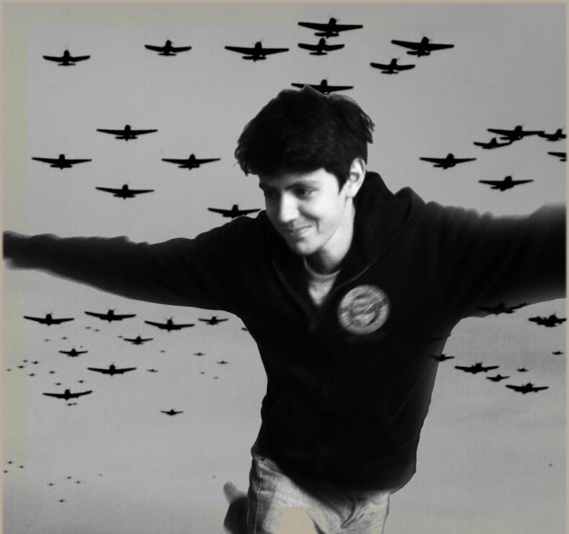
Resources
Production
Information
Logistics
Organisation
Technology
PILOT

Slide 5

Seanville
Low food!

Slide 6
PILOT interplay
Production

Slide 7
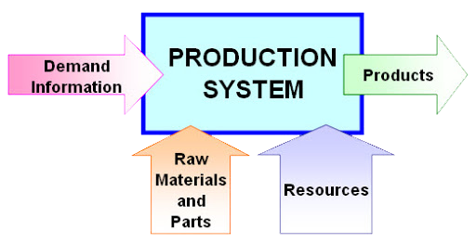
Production
Primary resources: Food, wood, metal, etc
Secondary resources build from primary
Tertiary from at least 1+ Secondary

Slide 8
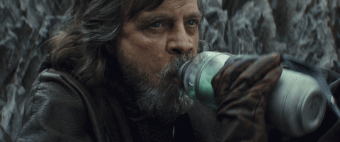

Seanville
50 Food
Low happiness!

Slide 9
PILOT interplay
Organisation
Production

Slide 10
Organisation
A measure of your national unity / happiness of the population
Affects the efficacy involving everything with a human resource cost
Also affects morale during battles

Slide 11



Seanville
LandyLand
Low food!
50 Food
Happy
Low metal!

Slide 12
PILOT interplay
Organisation
Production
Logistics

Slide 13
Logistics
Transferal of objects locations to other places
Handles supply/demand, and therefor overall costs of objects
Purchasing objects off the market tells the system to bring them to you
Provides food,

Slide 14

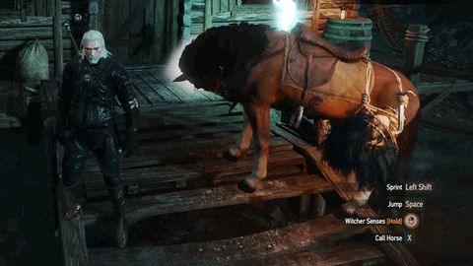
Seanville
LandyLand
-10 food +10 metal
50 Food
Low metal
40 Food
10 Metal

Slide 15
PILOT interplay
Organisation
Technology
Production
Logistics

Slide 16
Technology
Technology improves everything
It’s pretty good
It’s the tech tree basically
As tech increases so does the complexity of the system

Slide 17
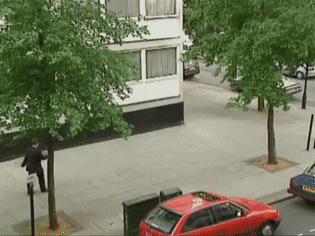


Seanville
LandyLand
-25 food +25 metal
-10 food +10 metal
40 Food
10 Metal
25 Food
25 Metal

Slide 18
PILOT interplay
Organisation
Information
Technology
Production
Logistics

Slide 19

Information
Captures the level of understanding you have on the other 4 systems
Logistics – the supply routes of others
Production – production rates, production types
Organisation – Troop movement, spies and national unity
Technology – Level of tech
Generated by spies and diplomacy

Slide 20



Seanville
LandyLand
-25 food +25 metal
CandyLandy
25 Food
25 Metal
Notes:
Items are saved to nodes OR houses (Though perhaps intrinsically to movement)
Upkeep

Slide 21

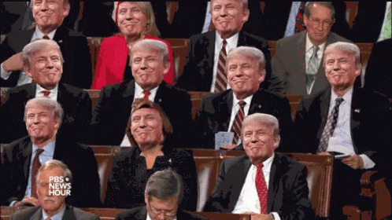



Warfare
CandyLandy

Slide 22
Battle Day 1
Battle Day 2
Strength 2.9
Strength 3
Strength 1
Strength 0.5

Slide 23





In battle
Time left till next day: 06:12

Slide 24
Offhand Warfare mentions
Number of shots = logistics + production
Morale = organisation + logistics
Enemy army size location, routes etc = Information
Technology = unit type (custom units)
Officer = gives bonuses, gains exp
Individual units exp, tier 1/2/3. New weapons halves the exp or something idk

Slide 25
The core tenants of Das
Accessible numbers
Complex webs
Active pace

